Slide 1
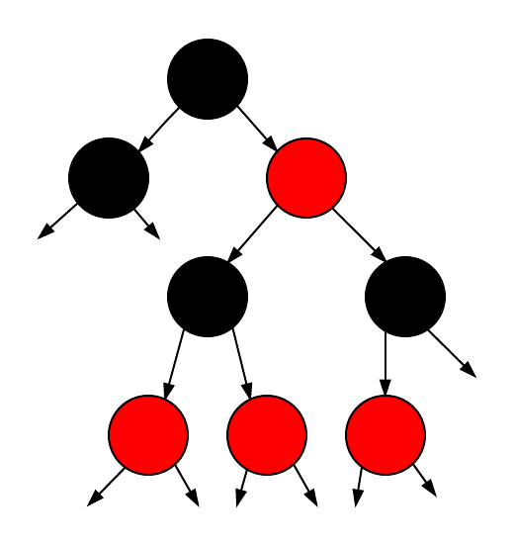
Red/Black BST
Nirmal Reddy
David Kao
Ravi Chandra
Satish Reddy
Daniel Sujay
Hareeshwar Reddy

Slide 2
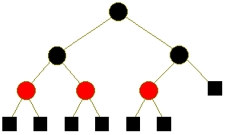
Agenda
What is Red/Black Tree
Properties
Applications
Insertion
Deletion
Complexity
Advantages
Dis-advantages
Conclusion

Slide 3
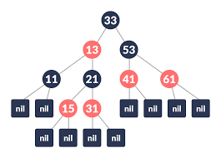
What is Red-Black Tree?
A red-black tree is a self-balancing binary search tree, that is, a binary search tree that automatically maintains some balance.
A red black tree is an extension of the binary search tree. This color information is used to ensure that the tree remains balanced during the insertion or deletion process.

Slide 4
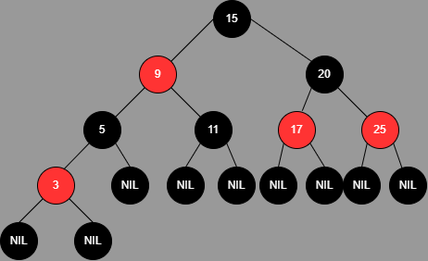
Properties:
Every node is either RED or BLACK
The root node of the tree is always BLACK
All NULL (leaf) nodes are always BLACK
There are no two adjacent red nodes
Every path from a node (including root) to any of its descendant's NULL nodes has the same number of black nodes
Notes:
Red-black tree of height h has black height >= h/2.
Number of nodes from a node to its farthest descendant leaf is no more than twice (2x) as the number of nodes to the nearest descendant leaf.

Slide 5
Applications Of Red/Black BST :
Compared to other algorithms, RB trees promise the fastest computational times for the INSERT, DELETE, and SEARCH operations. This enables their use in applications that are sensitive in terms of computation time, like real-time applications.
However, because of their properties, RB trees may also be used as the cornerstones of data structures that support a wide range of applications.

Slide 6
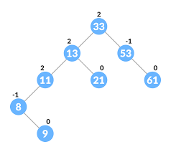
Examples :
1. AVL Trees :
The original self-balancing binary search tree was the AVL tree (Adelson-Velsky and Landis tree). The height difference between any two child subtrees in an AVL tree is one at most.
Rebalancing is necessary if this stipulation is not satisfied.
They are a subset of RB trees as a result. AVL trees are more strictly balanced because the worst-case height is 0.720 times greater than the worst-case height of RB trees.

Slide 7
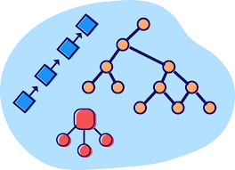
2. Tango Trees:
It is a type of binary search tree optimized for fast searches, specifically uses RB trees as part of its data structure.
3. Functional Programming:
Red/Black Trees are used to construct associative arrays.
4. Applications in JAVA:
TreeSet and TreeMap in java uses RED/BLACK Tree for Sorting and Ordering.

Slide 8
Insertion
How to Add?
Let y be the leaf (ie. NIL) and x be the root of the tree.
Check if the tree is empty .
If yes, insert new Node as a root node and colour it black.
Else, repeat steps following steps until leaf is reached.
1. Compare new Key with root Tree.
2. If new Key is greater than root Key, traverse through the right subtree.
3. Else traverse through the left subtree.
Assign the parent of the leaf as a parent of new Node.
If leaf Key is greater than new Key, make new Node as right Child.
Else, make new Node as left Child.
Assign NULL to the left and right Child of new Node.
Assign RED colour to new Node.
Call Insert Fix-algorithm to maintain the property of red-black tree if violated.

Slide 9
How to Maintain?
While the parent of newNode p is RED.
If p is the left child of grandParent gp of z, do the following.
Case-I:
If the color of the right child of gp of z is RED, set the color of both the children of gp as BLACK and the color of gp as RED.
Assign gp to newNode.
Case-II:
3. Else if newNode is the right child of p then, assign p to newNode.
4. Left-Rotate newNode. Case-III:
5. Set color of p as BLACK and color of gp as RED.
6. Right-Rotate gp.
Else, do the following.
If the color of the left child of gp of z is RED, set the color of both the children of gp as BLACK and the color of gp as RED.
Assign gp to newNode.
Else if newNode is the left child of p then, assign p to newNode and Right-Rotate newNode.
Set color of p as BLACK and color of gp as RED.
Left-Rotate gp.
Set the root of the tree as BLACK

Slide 10
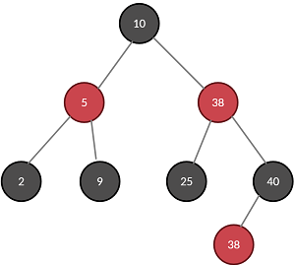
Deletion Process :
How to proceed for deletion depends on the number of children nodes to be deleted.
Notes:
If the node to be deleted has no children, we simply remove it.
If the node to be deleted has one child, we remove the node and let its single child move up to its position.
If the node to be deleted has two children, we copy the content (not the color!) of the in-order successor of the right child into the node to be deleted and then delete the in-order successor according to rule 1 or 2 (the in-order successor has at most one child by definition).

Slide 11
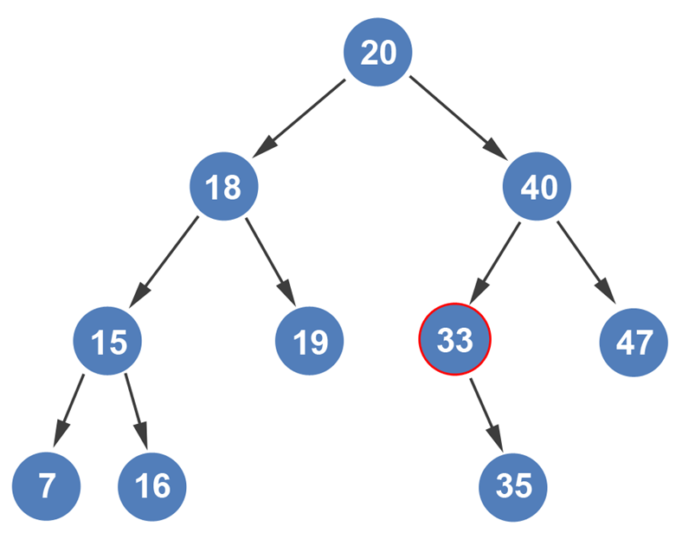
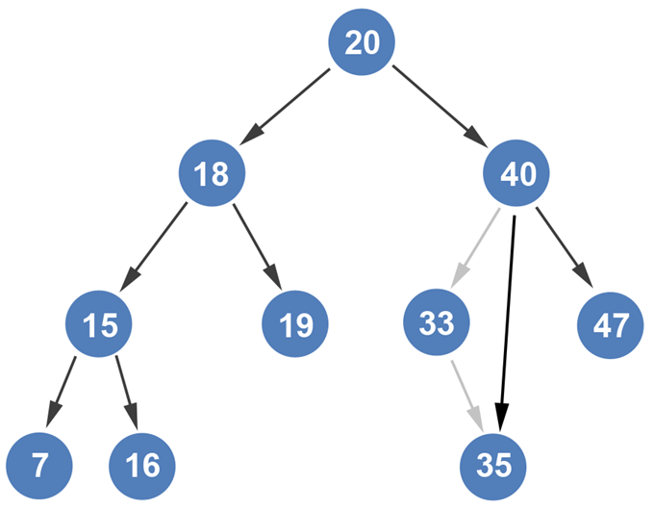
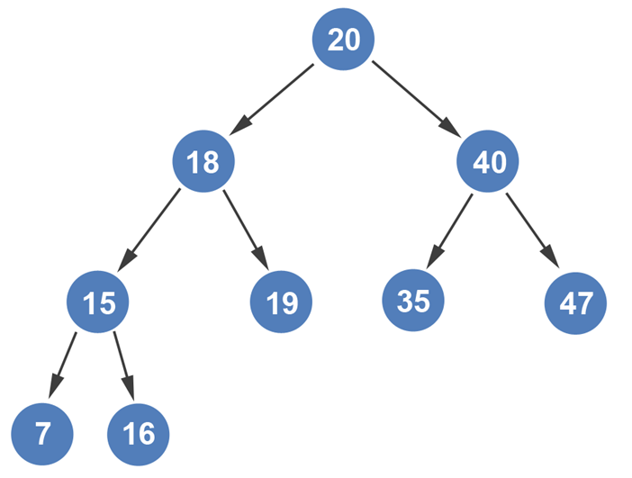
Deleting a Node with Zero or One Child
Notes:
Exactly what it sounds like. We’ll be deleting a node from a tree that has only one child. Let’s look at our tree and examine which nodes have one child. In our example, only node 33 has one child. All other nodes have two children.
If we removed node 47 from the list, we would have two nodes that have 1 child each; node 40 would have one immediate child and node 33 would have one immediate child. However, let’s keep the example as is. It is important for the reader to have this visual in their head though.
So, how would we delete node 33 from the tree shown above? That’s simple. Node 33’s parent, node 40, would point to node 33’s child after it severs the edge with node 33.
Node 35 would move into the place of node 33. If we examine the binary search tree, we can safely conclude that everything in the left subtree of each parent is less than the parent, and everything in the right subtree of each parent is greater than the parent.

Slide 12
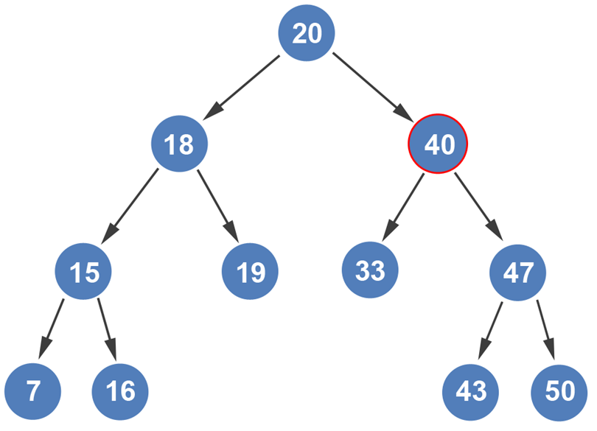
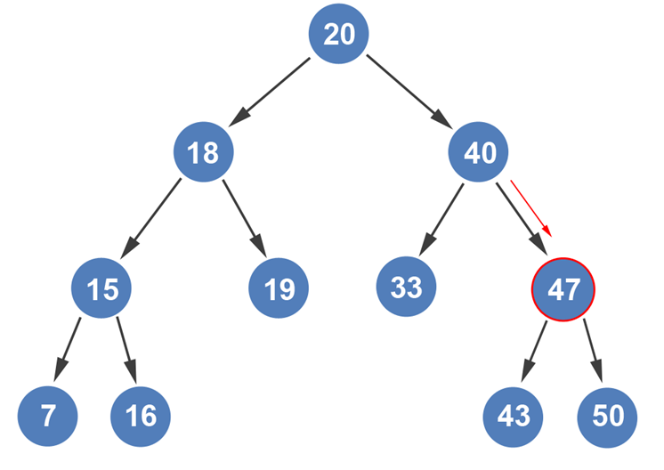
Deleting a Node with Two Children
Notes:
What would happen if we wanted to remove node 40 from the tree below?
Since node 40 has two children, we can’t simply point to its child and hope it works. There’s an algorithmic approach to this problem too. The way we remove this node is by replacing it with the next largest value. How do we get the next largest value? By going into the right subtree, and then following the left subtree until we get to the leaf node.
Let’s look at that more closely.
We enter node 40’s right subtree.
.

Slide 13
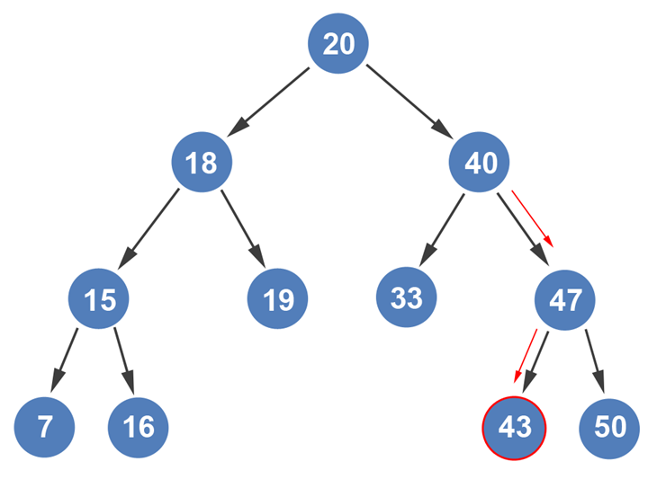
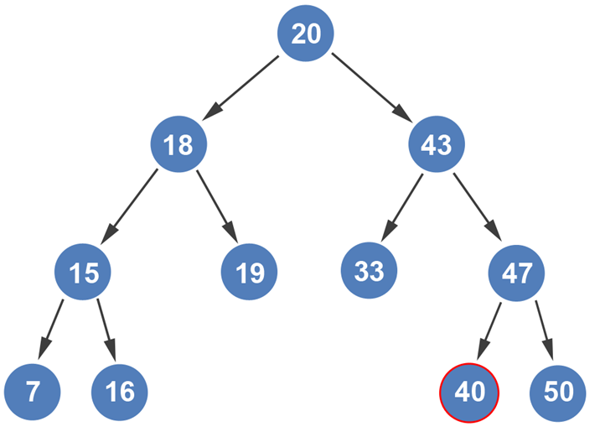
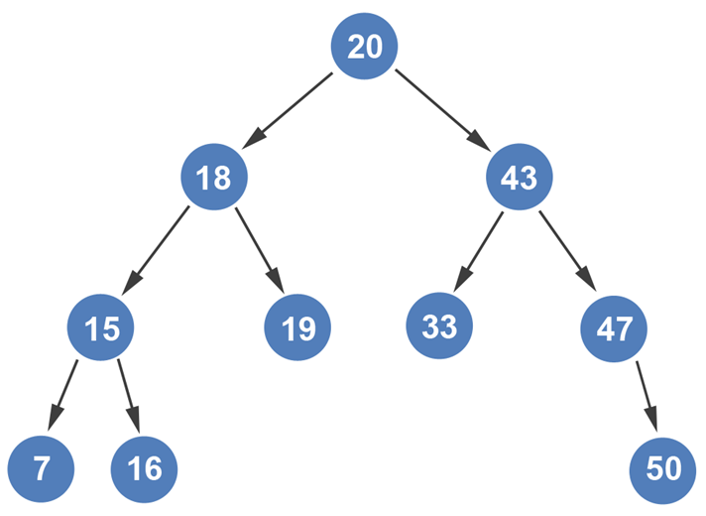
Notes:
We then follow the left subtree path until we get to a leaf node. So, we go to node 43.
Since node 43 is a leaf node, we swap node 40 with node 43.
We can now remove node 40 from the tree.
If we examine the tree, we can see that the binary tree properties still hold. All nodes in the left subtree are smaller than the parent, and all nodes in the right subtree are larger than the parent. Just remember, to remove a node that has two children, start by looking in its right subtree. The node on the far left in its right subtree is the node that will replace the node you’re trying to remove.

Slide 14
Insertion Time and Space Complexity
There are three phases to inserting a key into a non-empty tree :
1. First phase : The binary search tree insert operation is conducted because it is balanced the BST operation is O(height of tree), which is O(log n).
2. Second stage : The new node is then colored red, This step is O(1) since it only involves changing the value of one node's color field
3. Third stage : we restore any red-black characteristics that have been violated.

Slide 15
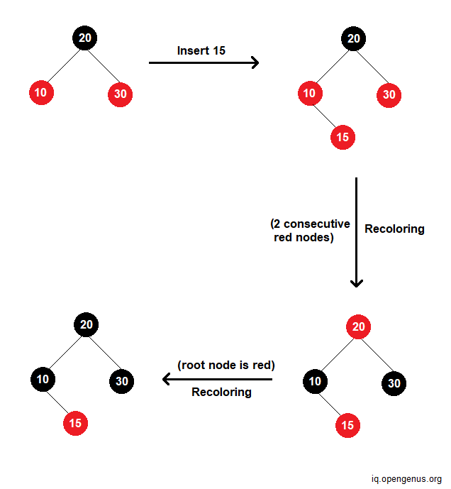
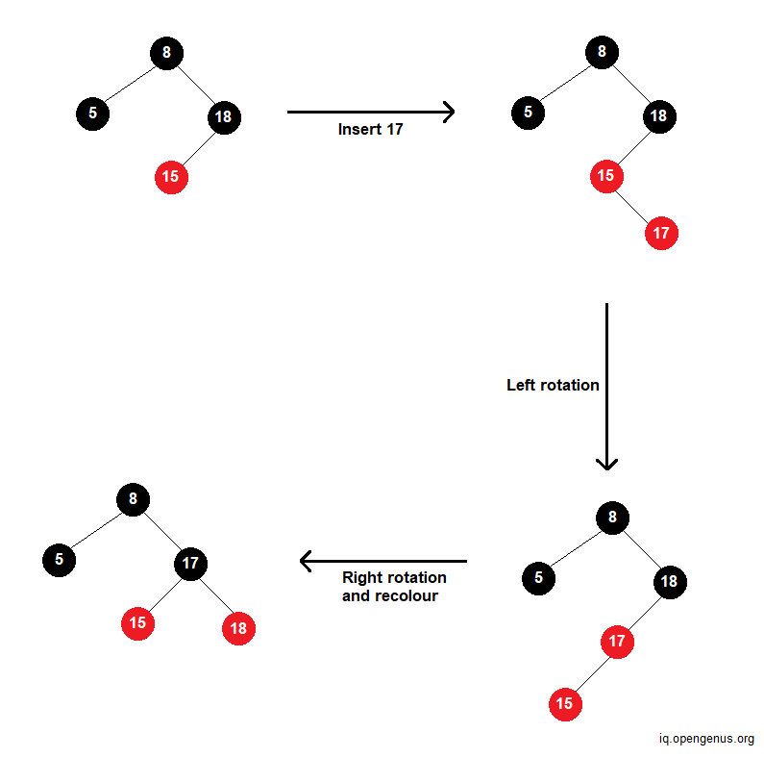
Insertion Time and Space Complexity
Best Case
Worst Case
Best Case :
In the best case, there is no rotation. Only recoloring takes place. The time complexity is O(log n).
Worst Case :
RB trees require a constant (at most 2 for insert) number of rotations. So in the worst case, there will be 2 rotations while insertion. The time complexity is O(log n).

Slide 16
Deletion Time and Space Complexity
Finding the delete node and the next node to its left is proportional to the height of the tree so it is O (log n).
Both the swapping and the deleting are O (1)
Each fix (like rotation) is marked with an O (1).
In the worst case, a double-black could get passed all the way up to the root. Because each rotation takes the same amount of time, this is proportional to the tree's height, and so O (log n).
Because of this, the worst case for deletion is O(log n).

Slide 17
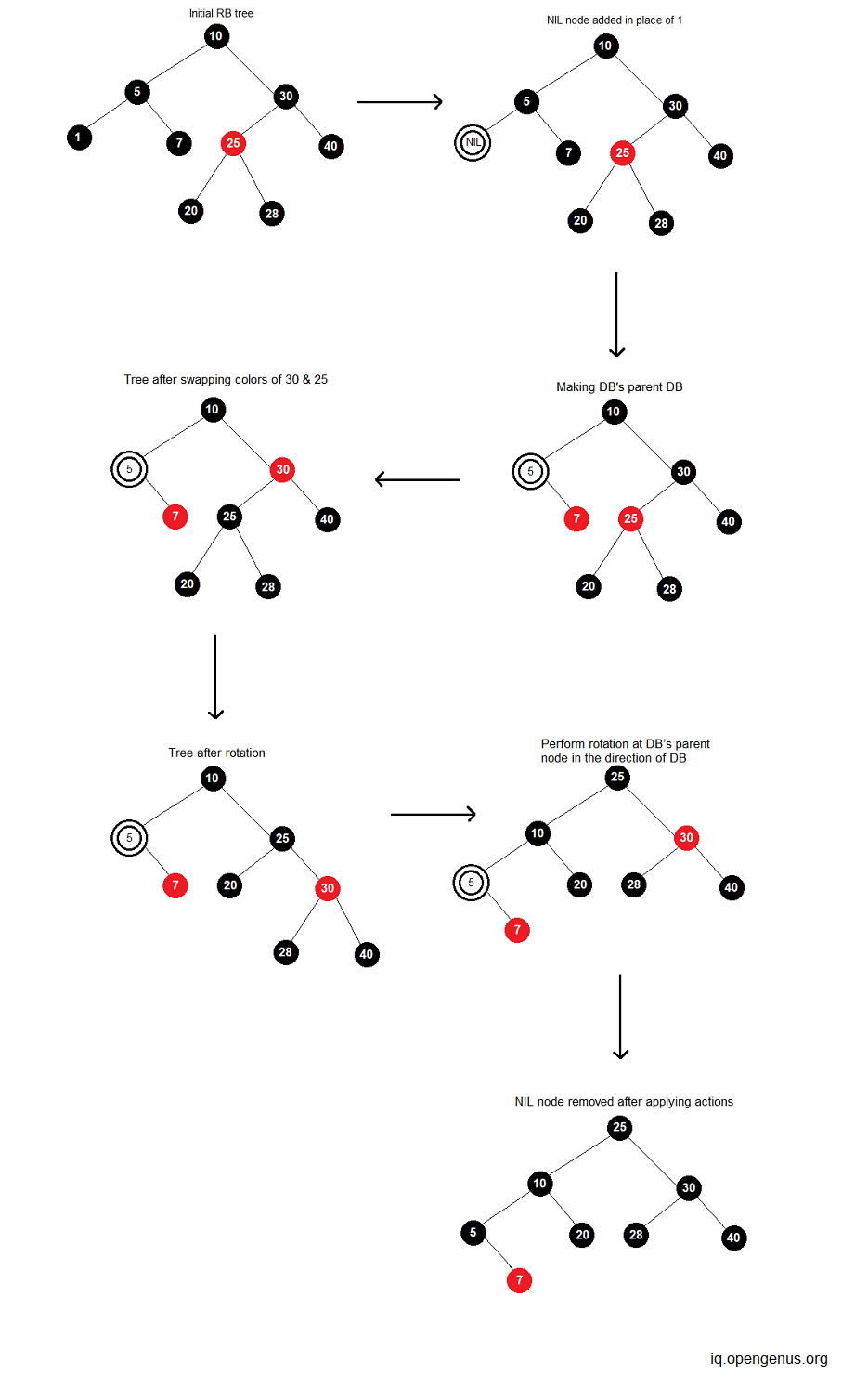
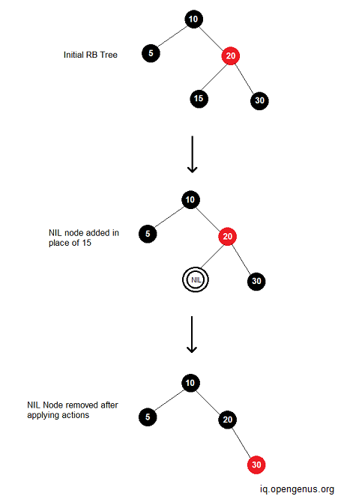
Deletion Time and Space Complexity
Average Case
Best Case
Best Case:
In the best case, there is no rotation. Only recoloring takes place. The time complexity is O(log n).
Example: Delete 15 from RB tree.
Average Case:
Since the average case is the mean of all possible cases, the time complexity of deletion in this case too is O(log n).
Example: Delete ‘1’ from RB tree.

Slide 18
Advantages:
The level of the parallel tree is balanced by red-black trees.
By reestablishing the level of the parallel tree, Red-Black Tree is given some room to shape the tree.
The search activity's temporal complexity is O
In a variety of circumstances, it has equally low constants.

Slide 19
Disadvantages:
Due of all the activity edge situations, it is difficult to use; typically, you should use a standard library execution rather than performing one on your own without any preparation.
(for example: TreeSet in Java, STL set in C++, and so forth)
AVL trees offer greater performance if your goal is to only create the tree once and then use it for read-only operations moving forward.
B-trees are frequently preferred over red-black trees for organizing and storing a large amount of data on plates because they can have a variable number of children.

Slide 20
Conclusion
Compared to a conventional binary search tree, the red-black tree requires an additional bit on every node to store the node's color, but because to its balancing characteristic, it performs all operations more quickly than the classic binary search tree. Due to its fewer rotations, the red-black tree performs insertion and deletion better than the AVL tree, but lookup takes longer since the AVL tree maintains a more rigorous balance than the red-black tree does.

Slide 21
References:
Parewa, (Programiz) Insertion in a Red-Black Tree. https://www.programiz.com/dsa/insertion-in-a-red-black-tree
John M. 1998. Data Structures and Algorithms. https://www.eecs.umich.edu/courses/eecs380/ALG/red_black.html
CS. February 25, 1998. Red Black Tree Deletion. https://www.cs.purdue.edu/homes/ayg/CS251/slides/chap13c.pdf
OpenG,Iq. 2022. Time and Space Complexity of Red Black Tree. https://iq.opengenus.org/time-and-space-complexity-of-red-black-tree/
Manasab.16 May, 2022. Applications, Advantages and Disadvantages of Red-Black Tree. https://www.geeksforgeeks.org/applications-advantages-and-disadvantages-of-red-black-tree/

Slide 22

THANK YOU

Slide 23

Any Questions?

